Slide 1
Rio 2016 Olympic Games

Slide 2
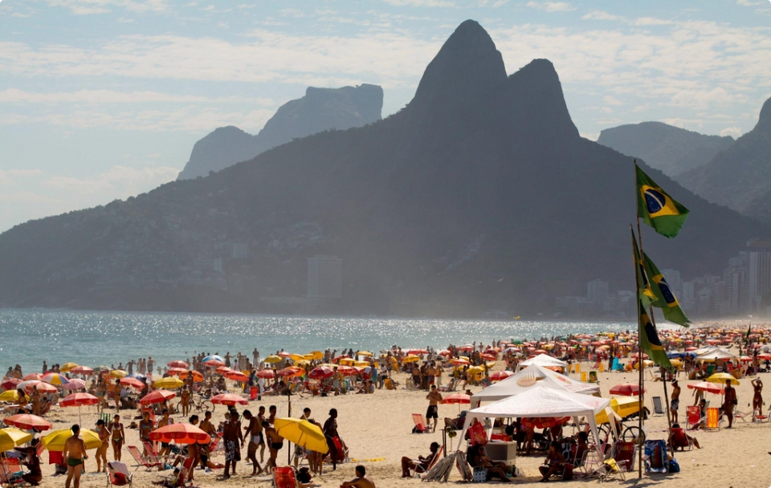
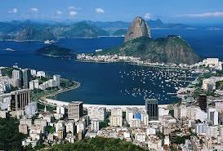
Where will you be in 2016?
Did you know that the Olympic Games will be held in Rio from August 5th to August 21^{st?}

Slide 3
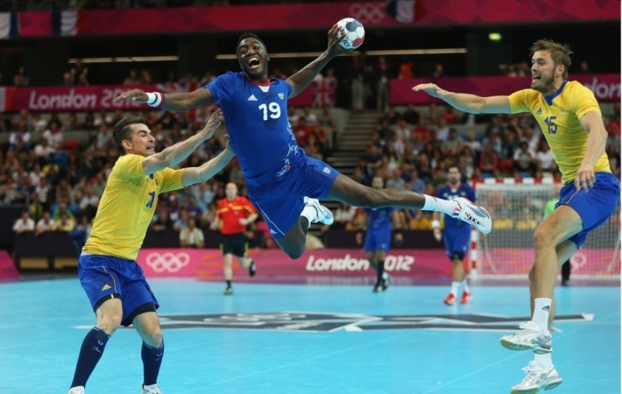
Do you like sports?
What do you know about the Olympic Games?

Slide 4
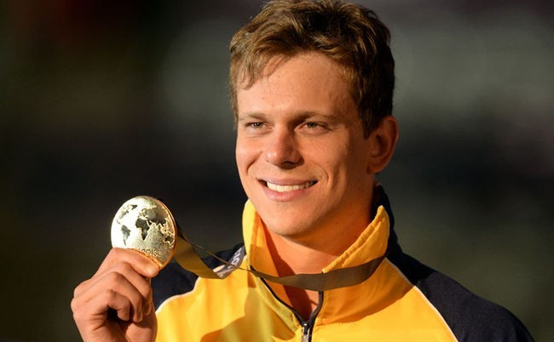
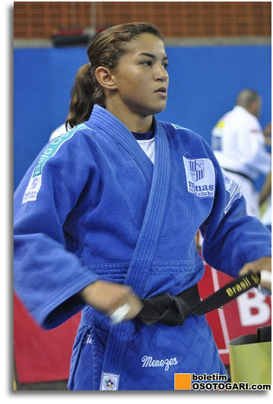
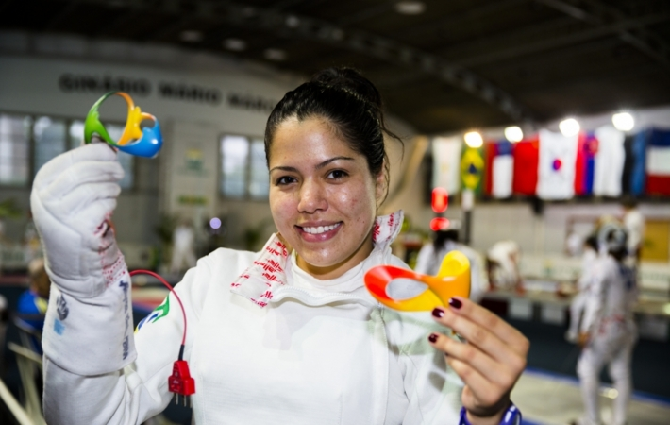
Are you ready to support our olympic athletes?

Slide 5
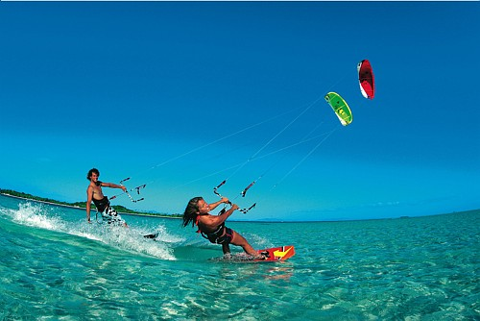
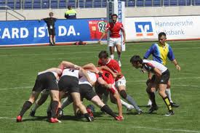
Join your team in this race to learn more about the history of the Olympic Games and the Olympic sports as well as three new Olympic sports that were included in the 2016 Rio Games.
Kitesurfing
Sevens Rugby
Golf

Slide 6
Did you know that the 2016 Summer Olympic programme features 28 sports? In this webquest you’ll have fun leaning more about some sports that aren’t very popular in Brazil and creating your own blog about the Olympic Games and a chosen sport. I bet you’ll score many goals and will win a gold medal!
So, let’s get started?

Slide 7
TASK
1st step: Make groups of three or four people.
2nd step: Choose one of the following sports:
Sevens Rugby
Golf
Kitesurfing
Water Polo
Badminton

Slide 8
TASK
3rd step: Using the suggested websites, make a research about the Olympic Games and the chosen sport.
4th step: after synthesizing all the information, create a blog to share your founds with friends.
Make sure to include the following aspects about the sport:
Its history;
Rules;
How to play it;
Famous athletes;
Pictures;

Slide 9
RESOURCES
How to create a blog:
http://www.wikihow.com/Start-a-Blog-on-Blogger
http://wordpress.com/#video
Rio 2016 Olympic Games:
http://rio2016.com/en
http://www.olympic.org/olympic-games
Sports:
http://en.wikipedia.org/wiki/Kitesurfing
http://en.wikipedia.org/wiki/Golf
http://en.wikipedia.org/wiki/Badminton
http://en.wikipedia.org/wiki/Sevens_rugby
http://en.wikipedia.org/wiki/Water_polo

Slide 10
EVALUATION
Your colleagues will judge your group performance and blog creation on a chart with "Very Good", "Good" and "Regular” on the following criteria:
Creativity
Layout
Language
Research
Your group must self-evaluate too. And finally, the teacher’s evaluation will complete the average.

Slide 11
EVALUATION CHART
Grade | Very Good | Good | Regular
Creativity
Layout
Language
Research
Coments:
Final Grade

Slide 12
CONCLUSION
Did you like this race?
Or did you run out of gas?
Was it fun to find out more about Rio Olympic games?
Have you ever heard about this new sports?
Are you ready to support our athletes on this new Olympic sports?
How about exploring it further? Let’s keep moving!
Check out this other sites for more information!
http://www.topendsports.com/events/summer/hosts/rio/sports.htm
http://www.rio2016.com/en/the-games/paralympic/sports
http://www.olympic.org/athletics-road-equipment-and-history
http://swimming.about.com/od/swimmingolympics/a/olympicswimbasi.htm

Slide 13
CREDITS
This webquest was created by Isabele Mendes and Sérgio ...., under guidance of Professor Janaína Cardoso for the course “Use of Technology for English Language Teaching” at UERJ in Decemeber, 2013.
This activity was designed to help pre-intermediate and intermediate students improve their writting and speaking skills.

